Slide 1
A Robotics Simulation of Krusty Krabs Restaurant
AI Planning for Robot Systems
24CSAI04H
amir224030, merihan226392
omar228248, sameh218767

Slide 2
TABLE OF CONTENTS
01
Overview
02
03
Objectives and Features
Implementation
details
Environment and Mapping
04
05
06
Algorithms
Conclusion
Testing and Results
A* and Dijkstra

Slide 3
Overview
Our project implements multiple agents that map, use, and traverse their environment using path- planning algorithms, namely A* and Dijkstra’s, while accounting for both dynamic and static obstacles with the goal of gathering all the coins dropped in the map in a timely manner according to priority.
sameh218767

Slide 4
Objectives and Features
▪Implement a dynamic environment using A* and Dijkstra’s algorithms with multi-agents
▪Use SLAM to allow our bots to create and map our environment.
Allow agents to navigate and evade dynamic and static obstacles in the most efficient manner possible.
▪Handle dynamic obstacles in real-time through the logic of our algorithms.
▪Implement prioritization of coins by creating the path around them based on value.
Create a communication protocol between the agents to divide, prioritize and gather all coins in the map.
sameh218767

Slide 5
Implementation Details
Design
Development
Libraries
Ibis Paint X for creating assets.
Python, PyGame, VS Code, and Jupyter Notebooks.
NumPy for matrix handling,
Queue for path-finding algorithms.

Slide 6
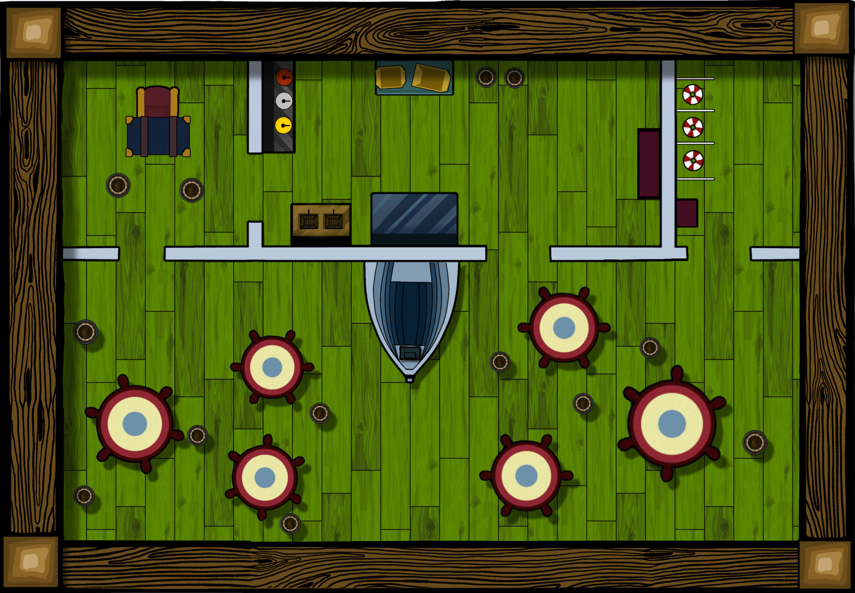







environment and Mapping
Dynamic Obstacles
Agents
Static Obstacles
Targets

Slide 7
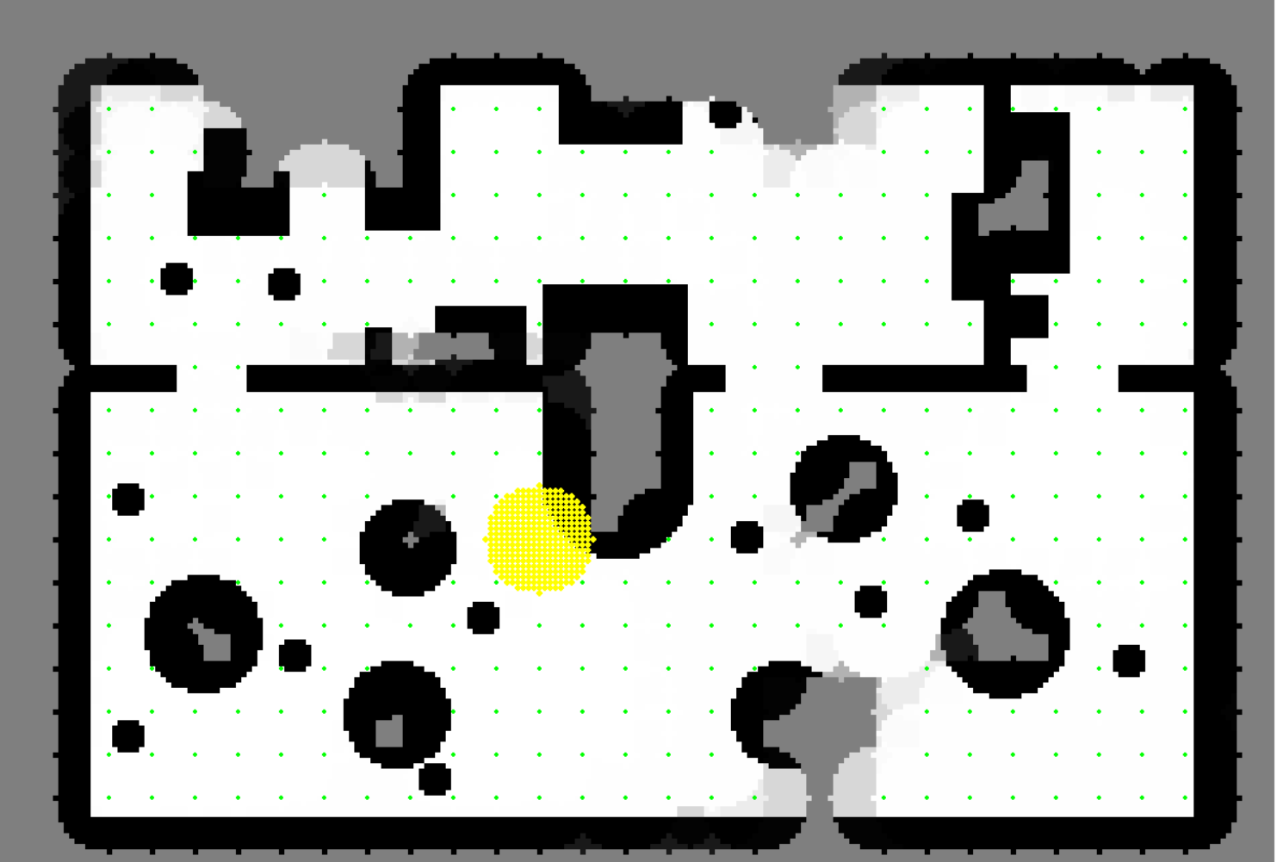

environment and Mapping
The environment is represented as a 2D occupancy grid. It begins with the robot sensing the obstacles around, making a random move, and updating the occupancy grid. Inverse sensor model-the algorithm calculates the probability of each sensed cell whether it is an obstacle or not. The calculated probabilities get logged and then updated.
825
1189
sameh218767

Slide 8
Path-finding Algorithms
A*
DIJKSTRA
Finds shortest path with heuristic-based prioritization.
Avoids both static and dynamic obstacles.
Calculates minimum cost path, avoiding all obstacles.
Performs well in environments with unpredictable obstacles.

Slide 9
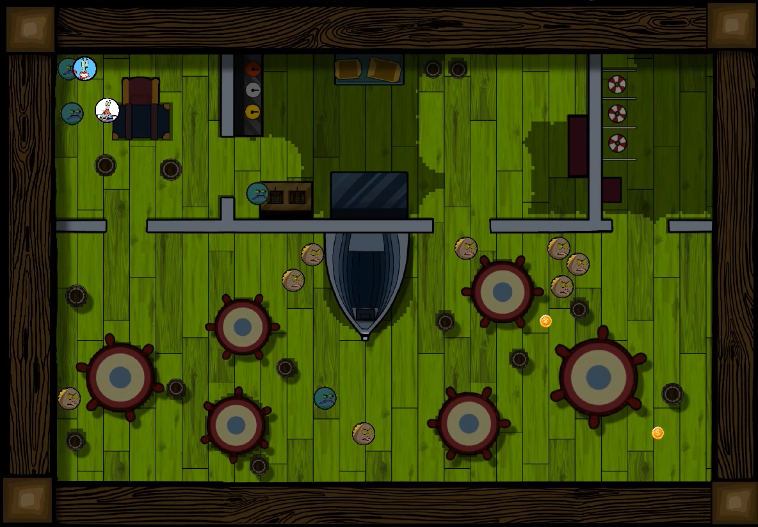
A* Emergency Case

Slide 10
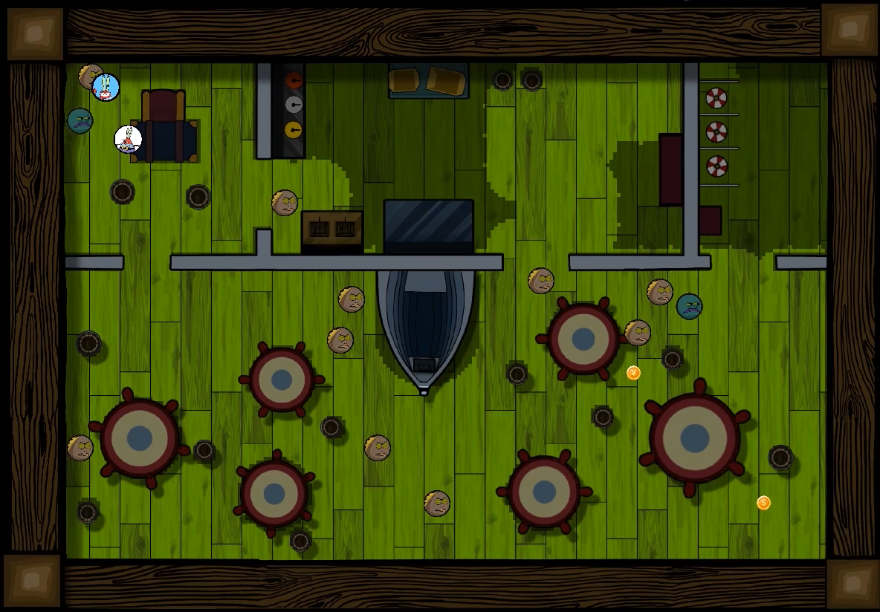
Dijkstra Emergency Case
sameh218767

Slide 11
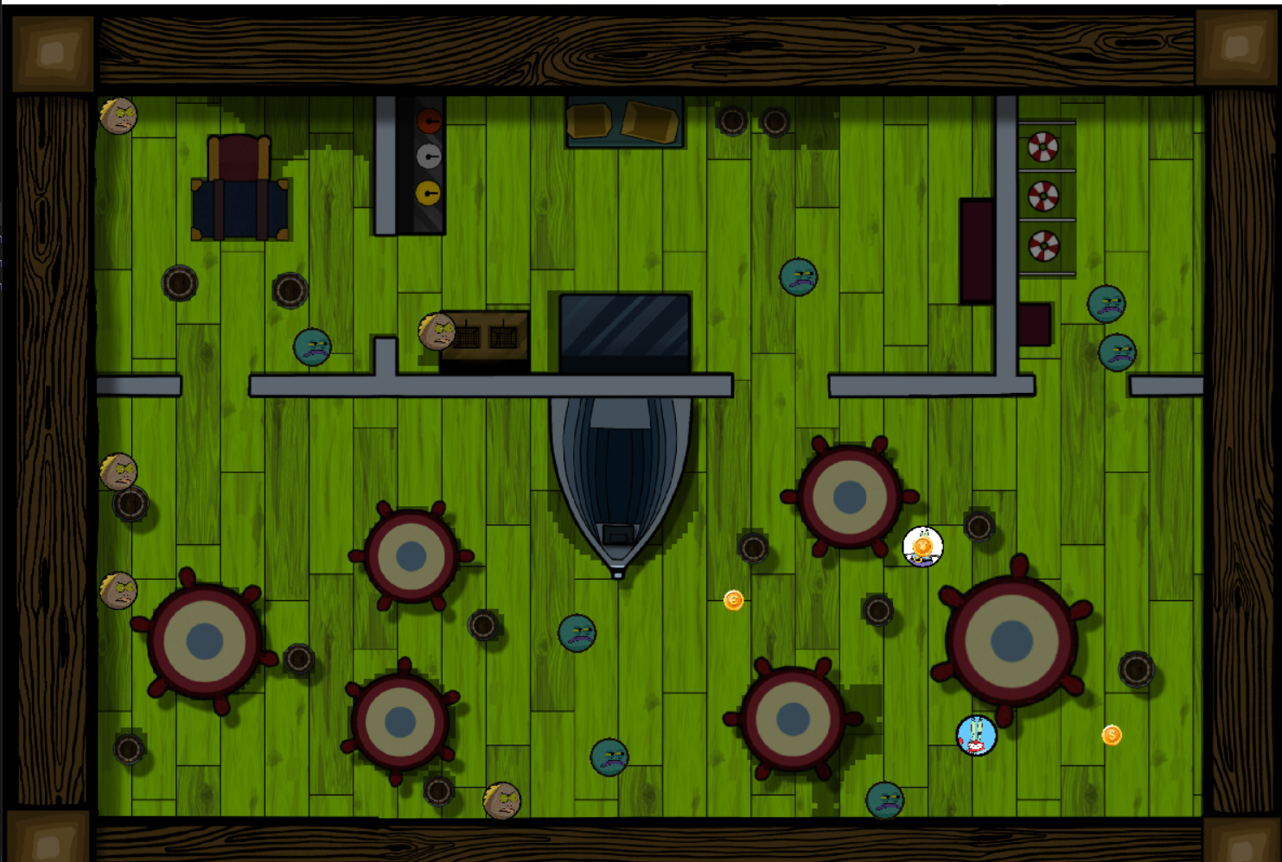
Testing and Results
We presented a couple of test cases to the agents – normal, high traffic and emergency. Each test case with different number of dynamic obstacles (4, 8, and 12 respectively). We then measured the time (in seconds) it took for each of the planning algorithms to reach the targets, one target each for each test case.

Slide 12
Testing and Results
 | A* | DIJKSTRA
Normal | 12.29 | 11.74
High Traffic | 14.08 | 13.76
Emergency | 16.00 | 16.27
sameh218767

Slide 13
Conclusion
Thank
You
The results aren’t totally conclusive as there is the random factor of dynamic obstacles movement as well as an inherit bias in the direction they choose to go to, which is based on their starting points. However, from the data we gathered we can say that A* performs slightly better than Dijkstra for most cases, while Dijkstra prevails ever so slightly in the emergency case.
sameh218767

